Slide 1
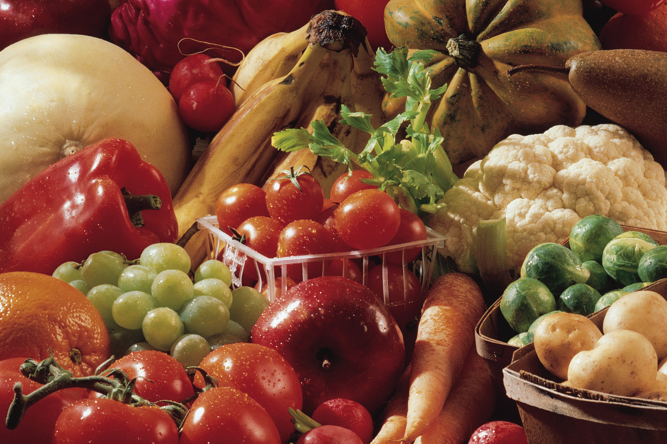
“Pre and post harvest factors affecting quality in postharvest shelf life of fruits and vegetables.”

Slide 2
Pre harvest factors affecting quality
-harvest factors
1)Cultivar and root stock genotype:
-It plays an important role in determining the taste, quality, yield, nutrient
composition and post harvest life of fruit and vegetable.
2)Water supply (irrigation)
- Excess rain or irrigation, leads to brittle and easy damage in leafy vegetables and to reduced tendency to decay.
- Lack of rain or irrigation leads to low juice content and thick skin in citrus fruit.
- Dry condition followed by rain or irrigation leads to growth cracks in tomato or secondary growth in potatoes.
3) Soil fertility and use of fertilizers
-Lack of nutrients in the soil can seriously affect the fresh produce at harvest. Too much of fert…… can harvest the development of post harvest condition of some produce.

Slide 3
4)Mineral nutrition
Deficiencies or excess or imbalance of various nutrients are known to result in disorders that can limit the storage life of many fruit and vegetables.
5)Foliar nutrient spray
Ca is often considered to be the most important mineral dement in determining fruit quality, especially in apples and pears where it has been demonstrated to reduce metabolic disorders, maintain firmness and reduce decay.
6)Cultivation practices:
Good management practices are very much important in achieving good yields and quality of fresh produced (i.e. weed control, crop hygiene, pesticides and herbicides, growth regulating chemicals).

Slide 4
Post harvest factors affecting quality
1)Curing:
It is done immediately after harvesting. It strengthens the skin.
The process is induced at a relatively higher temperature and humidity involving sterilization of outer tissues followed by the development of wound periderm which acts as an effective barrier against infection and water loss.
It is favored by high temperature and high humidity.
Potato, sweet potato, colocasia, onion, garlic are cured prior to storage or marketing.

Slide 5
In Sweet potato this condition is most rapid at 33^{O}C and relative humidity of 95%.
Potato tubers are held at 18^{O}C for 2 days and then at 7^{O}C-10^{O}C for 10-12 days at 90% relative humidity. Curing also reduces the moisture content especially in onion and garlic.
Drying of superficial leaves of onion bulbs protects them from microbial infection in storage.
Maximum safe temperature for onion curing at field is 37.8^{O}C for 3-5 days.
Artificial curing of onions in crates at 40^{O}C for 16 hours reduces rot losses in storage.

Slide 6
2)De-greening: It is the process of decomposing green pigments in fruits usually by applying ethylene or other similar metabolic inducers to give a fruit its characteristic colour as preferred by the consumer.
It is applicable to banana, mango, citrus and tomato.
The time required to degreen a fruit depends upon the degree of natural colour break at maturity.
The higher the green colour and more mature a fruit is, the less time is required to reduce the chlorophyll to a desired level.
De-greening is carried out in special treating rooms with controlled temperature and humidity in which low concentrations ethylene (20ppm) is applied to keep the CO2 level below 1 % (Low colouring). The ethylene should be supplied from a gas cylinder.

Slide 7
These rooms are thoroughly ventilated to keep the CO2 level below 1%, which does not allow higher colouring.
Ethylene accelerates decomposition of chlorophyll without significantly affecting the synthesis of carotenoids pigments.
The best degreening temperature is 27⁰C. Higher temperature delay degreening.
The Relative humidity should be 85-90%. Higher humidity levels cause condensation during degreening and are associated with slow degreening and increase in decay.
Low humidity though checks decay causes excessive shrinkage, shriveling and peel break down.

Slide 8
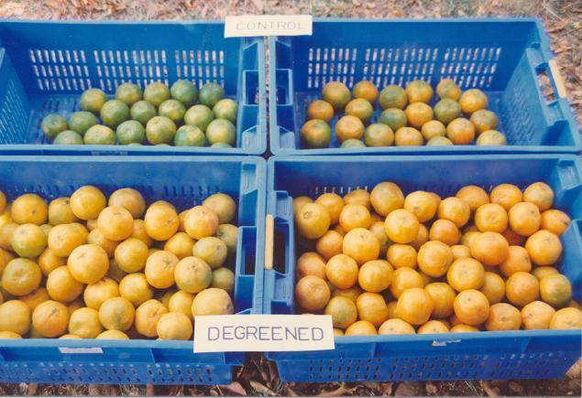

Slide 9
3)Washing and drying:
Most of the fruits and vegetables are washed after harvesting to improve their appearance, prevent wilting and remove primary inoculum load of micro organisms. Hence fungicide or bactericide should be used in washing water.
Washing improves shelf life of bananas by delaying their ripening. After washing excess of water should be removed this would otherwise encourage microbial spoilage.
Root and tuber crops are often washed to remove the soil adhering to them.

Slide 10
(4) Sorting and grading:
Immature, diseased and badly bruised fruits and vegetables are sorted out.
Most of the countries have their own set of standards of domestic trade and for international trade standards have also been defined.
Grades are based on size, weight, colour and shape.
Grading is done manually or mechanically.

Slide 11
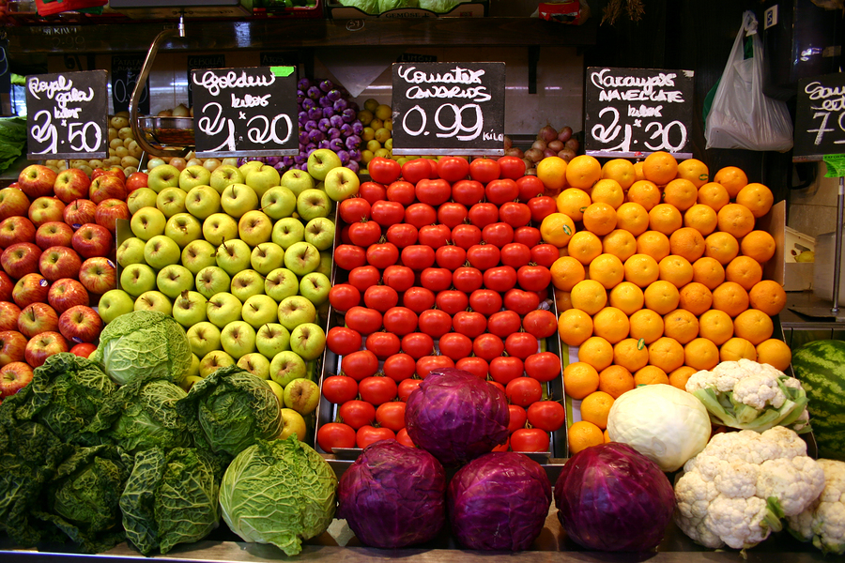
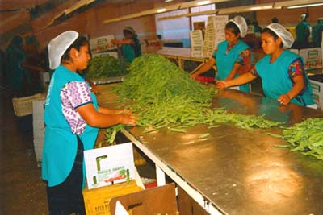
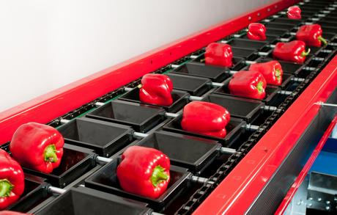
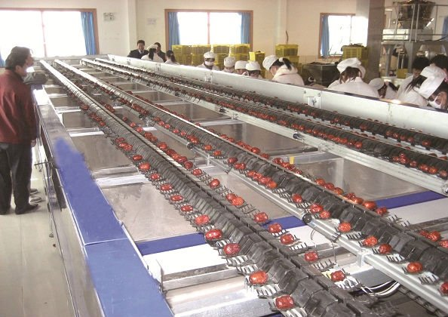
Grading

Slide 12
5)Post harvest treatments:
Post harvest application of Bavistin (0.1%) and topsin (0.1%) controls storage diseases in mango.
In Nagapur mandarins, hot water treatment with Imazalil (0.1%), Bavistin (0.1%) and Benlate (0.1%) is most effective.
A complete inhibition of sprouting of cool chamber (evaporatively cooled) stored potatoes for 4 months and 5 months is achieved by spraying them with an aqueous emulsion of CIPC @ 50 mg and 100 mg/kg of tubers respectively before completion of dormancy period.

Slide 13
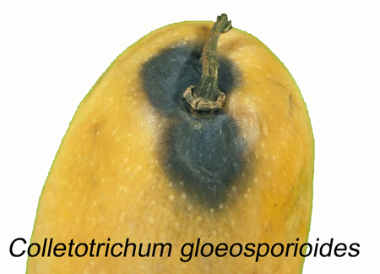
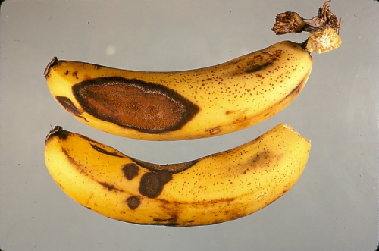
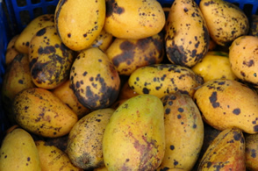

Slide 14
6)Waxing:
Fruits and vegetables have a natural waxy layer on their outer surface which is partly removed by waxing.
An extra layer of wax is applied artificially with sufficient thickness and consistency to prevent an aerobic condition within the fruits provides necessary protection against decay organisms.
Waxing is especially important if tiny injuries and scratches on their surface are present. These can be sealed by wax.
Waxing also enhances the glossiness of fruits or vegetables. Therefore, appearance is improved making them more acceptable.

Slide 15
If refrigerated storage facilities are not available, protective skin coating with wax increases the storage life of fresh fruits and vegetables at ambient temperature.
There are two types of wax emulsions.
Wax-W-which does not impart any gloss to fruits and vegetables, where as
Wax ‘O’ impart gloss.
The application of wax emulsion to freshly harvested healthy produce protects them against excessive moisture loss, higher rate of respiration, heat build up or thermal decomposition.
The texture and quality of fresh produce is maintained as nearer to the fresh conditions as possible for a long time.

Slide 16
Thank You

