Slide 1
IMPORTANT CATTLE BREEDS AND THEIR CHARACTERISTICS
What is breed:-
A group of animals related by descent and similar in most characters like general appearance, features, size, configuration etc.
What is species:-
A group of individuals which have certain common, characteristics that distinguish them.

Slide 2
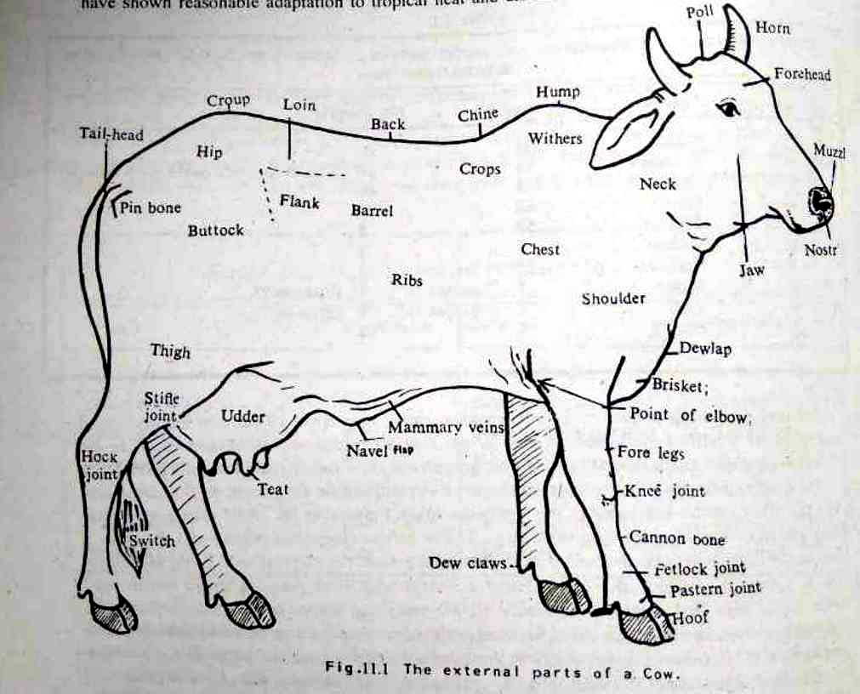
External body part of cow

Slide 3
Classification of indigenous cattle breed on the basis of utility
Milch purpose | Dual purpose | Draught purpose
Cows are high yielder varies from 1500 to 2500 lt per lactation. | Animal have intermediate between milch and drought breed, milk yield varies from 1200 to 1500 lt per lactation. | Bullock are excellent draft animals, while the cows are poor milkers.
Gir Sahiwal Red sindhi Tharparkar | Hariana Ongole Kankrej Deoni Nimari Dangi Mewati Rathi | Hallikar 8. Kenkatha Amritmahal 9. Kherigarh Khillari 10. Kangayam Bargur 11. Ponwar Nagori 12. Siri Bachaur 13. Gaolao Malvi 14. Krishna Valley

Slide 4
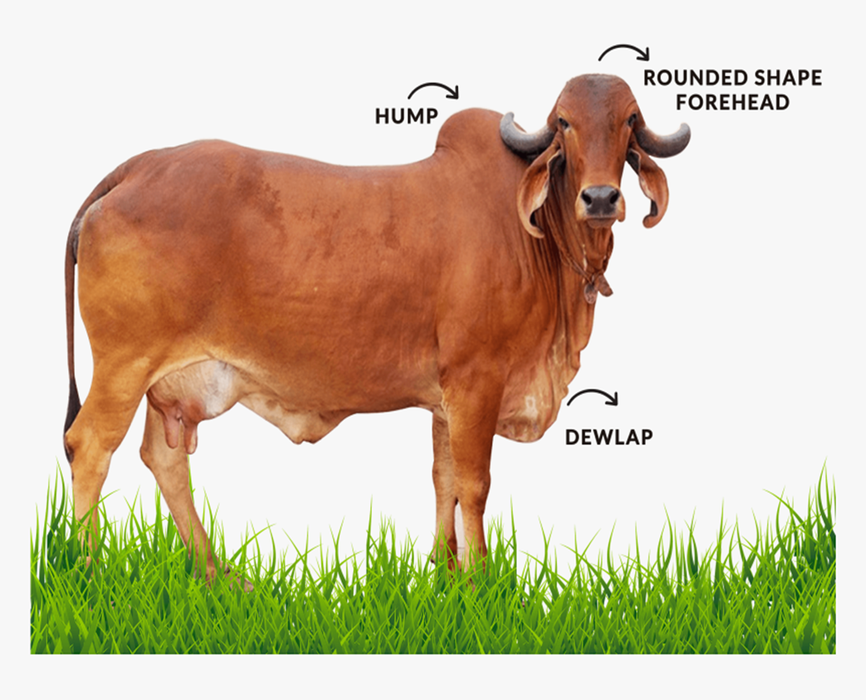
GIR
Synonyms:- Kathiawarhi, Surti, Decan.
rigin:- Gir forest of south Kathiawar Gujrat
Physical characters:- 1. Pendulous ear, horn give “Half moon appearance”
2. Head is moderately long but bony forehead,
3. Tail is long, whip like with a black switch
4. Colour is red to brown or black
5. Cow wt 386 kg & bullock wt 544 kg
Economic characters:- Age at 1 st calving 45- 54 month & inter calving period 515-600 days. yield is 1746 kg milk in 300 days of lactation.

Slide 5
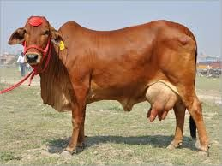
SAHIWAL
Synonyms:- Lola, Montgomery, Lambi-Bar, Multani
Origin:- Montdomery district in Pakistan, Panjab, Delhi, UP
Physical characters:- 1. Deep body with loose skin, Stumpy horns
2. Red, Pale red and dark brown colour
3. Horns are short and thick, loose horns in female
4. Massive hump, voluminous dewlap & pendulous sheath
5. Whip like tail reaching to the ground, black switch
6. Cow wt 340 kg & bullock wt 522 kg
Economic characters:- Yield is 2150 kg milk in 300 days of lactation.

Slide 6
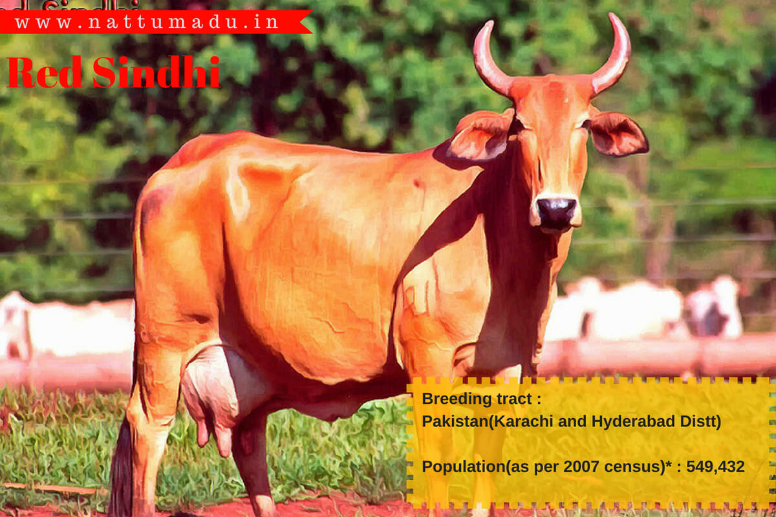
Red sindhi
Synonyms:- Red karachi
Origin:- Karachi and hyderabad
Physical characters:- 1. Medium size and compact body having thick horns, intelligent facial expression
2. Dark red colour, male are darker red than cow
3. Heavy hump, dewlap and sheath
4. Capacious udder
5. Cow wt 295 kg & bullock wt 450 kg
Economic characters:- Age at 1 st calving 39 50 month & inter calving period 425-540 days. yield is 1474 kg milk in 300 days of lactation.

Slide 7
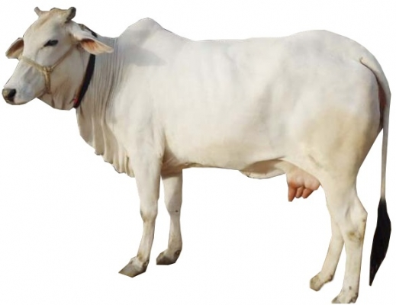
tharparkar
Synonyms:- Thari, Grey sindhi, White sindhi, Cutchi
Origin:- Tharparkar district of Pakistan, hyderabad
Physical characters:- 1. Medium size body,
2. Broad poll and forehead is convex with medium size horns
3. Moderately developed dewlap,
4. Colour is white or light grey
5. Tail with black switch
Economic characters:- Age at 1 st calving 38- 42 month & inter calving period 430-460 days. yield is 1474 kg milk in 300 days of lactation.

Slide 8
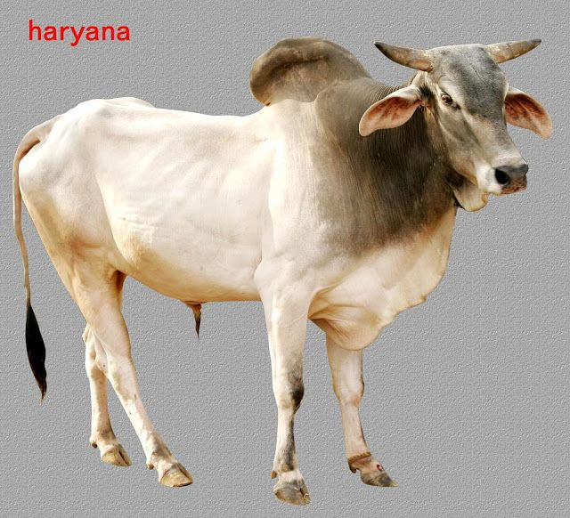
hariyana
Origin:- Punjab, Rohtak, Hissar, Gurgaon
Physical characters:- 1. Compact body, long and narrow face, prominent at poll
2. Horns are short curving upward and inward,
3. Tail is short, with a black switch reaching just below the hocks
4. Colour is white or light grey
5. Udder is capacious
6. Pin bone are prominent
Economic characters:- Age at 1 st calving 40- 60 month & inter calving period 515-600 days. yield is 1400 kg milk in 300 days of lactation. Bullock are good working animal.

Slide 9
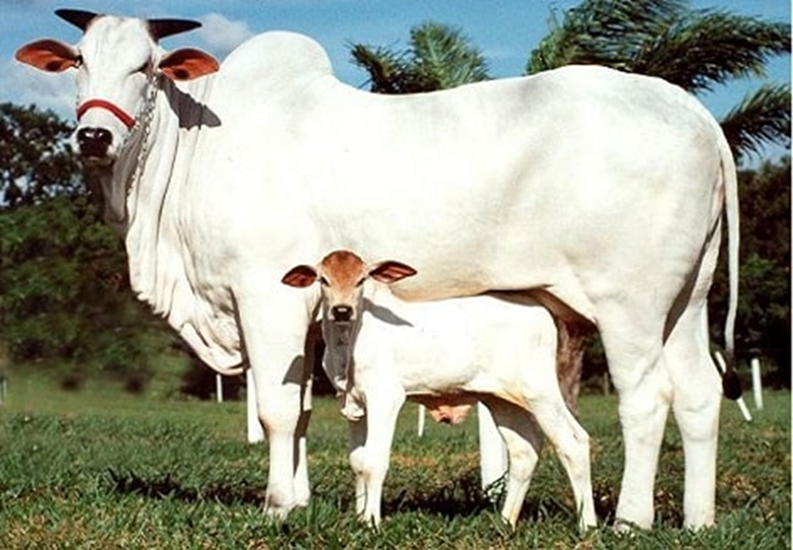
ongole
Synonyms:- Nellore
Origin:- Ongole tract of AP, Guntur district
Physical characters:- 1. Large, heavy and muscular
2. Forehead is broad with stumpy horns thick at the base
3. Hump is well developed and erect
4. Colour is white, male are darker grey
Economic characters:- Age at 1 st calving 38-45 month & inter calving period 470 days. yield is 1255 kg milk in 300 days of lactation. Bullock are powerful suitable for cart and road work

Slide 10
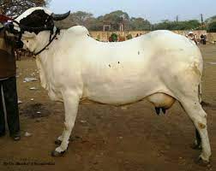
deoni
Synonyms:- Dongarpatti, Dongari, Wannera, Waghyd
Origin:- Latur district of Maharastra
Physical characters:- 1. Medium heavy animal
2. Colour is white in Wannera and Balankya Strain while black spot on body in Shevara strain
3. Head is masculine, alert, broad
4. Forehead is broad and bulging
5. Horns are medium, thick, apart, emerging from side of the poll
6. Tail is long whip like with black and white switch
Economic characters:- Age at 1 st calving 43 month & inter calving period 447 days. yield is 900 kg milk in 300 days of lactation.

Slide 11
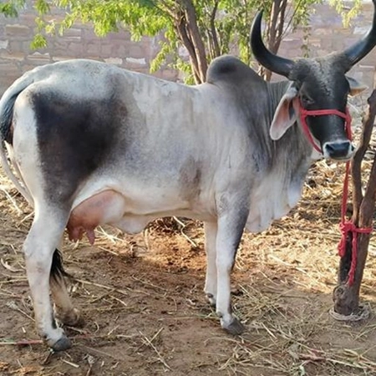
kankrej
Synonyms:- Bannai, vagadia, Wadhair, Nagu, Sanehore
Origin:- Kutch in Ahmedabad district of Gujarat
Physical characters:- 1. One of the heaviest of Indian breed, broad chest, forehead dished in center
2. Colour is silver grey, iron grey or black, well developed hump
3. Gait is particular to breed known as swai-chal
4. Tail is moderate length with black switch
5. Horns have lyre shaped and cover with skinto higher point than other breed
Economic characters:- Yield is 1333 kg milk in 300 days of lactation.

Slide 12
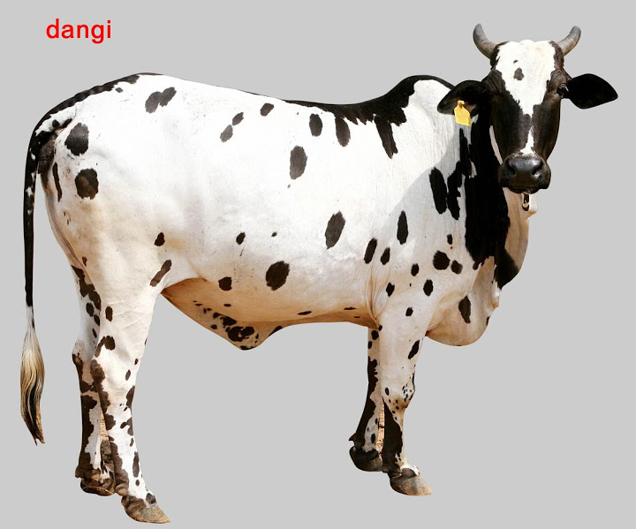
dangi
Synonyms:- Kalkheri, Sohkheri
Origin:- Ahmednagar, Nasik of Maharastra
Physical characters:- 1. Medium sized body with oily skin
2. Colour is red and white or black and white
3. Horns are short but thick
4. Bullock Wt. 362 kg, cow Wt 295 kg
Economic characters:- Age at 1 st calving 43 month & inter calving period 460 days. yield is 900 kg milk in 300 days of lactation.

Slide 13
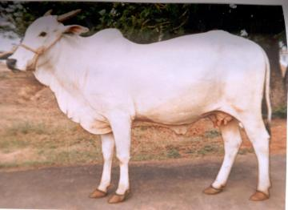
mewati
Synonyms:- Kosi
Origin:- Alwar region of Rajasthan
Physical characters:- 1. deep and powerfull frame
2. Face is long bit narrow, bulging forehead
3. Colour is white with dark head, neck and Shoulders.
4. Horns emerge from outward angles
5. Bullock Wt. 385 kg and cow Wt 326 kg
6. Tail is long
Economic characters:- Bullock are powerful, avg milk yield 4.55 kg per day

Slide 14
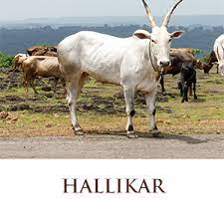
hallikar
Origin:- Hassn and Tumkur district in KT
Physical characters:- 1. Medium size animal, compact and muscular
2. Head is long and bulging forehead
3. Horns are backward on side of the neck and curving upward to terminate in sharp point
4. Colour is grey to dark grey
5. Hump is moderately developed
Economic characters:- Bullock are excellent draught type. Cow are poor milker.

Slide 15
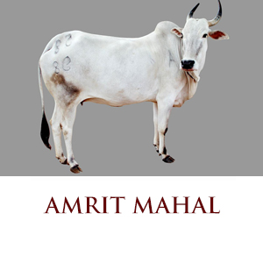
amritmahal
Origin:- Karnataka
Physical characters:- 1. Body is compact with short straight back, well arched rib
2. Prominent forehead with narrow face with furrow in middle
3. Long sweeping horn
4. Well developed hump and dewlap
5. Tail is moderate length and black switch
6. Grey colour body with dark head, neck, hump and quarter
Economic characters:- One of the best drought breed in Indian animal. Cow is not so good milker

Slide 16
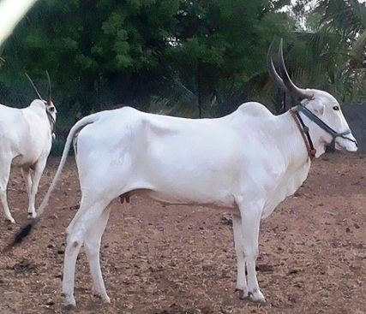
khillari
Origin:- Solapur and Satara district of Maha.
Physical characters:- 1. It has compact body.
2. Mhaswad khillari is greyish colour with typical mottled markings on face
3. Tapi khillari is white with pink nose
4. Nakali khillari is grey with tawny or brick dust colour over the fore quarter
5. Horn are long pointed, emerging close to each other follow the backward curve of the forehead
6. Legs are clean cut straight, shoulder are tightly muscled
Economic characters:- Bullock are excellent draught type. Cow are poor milker.

Slide 17
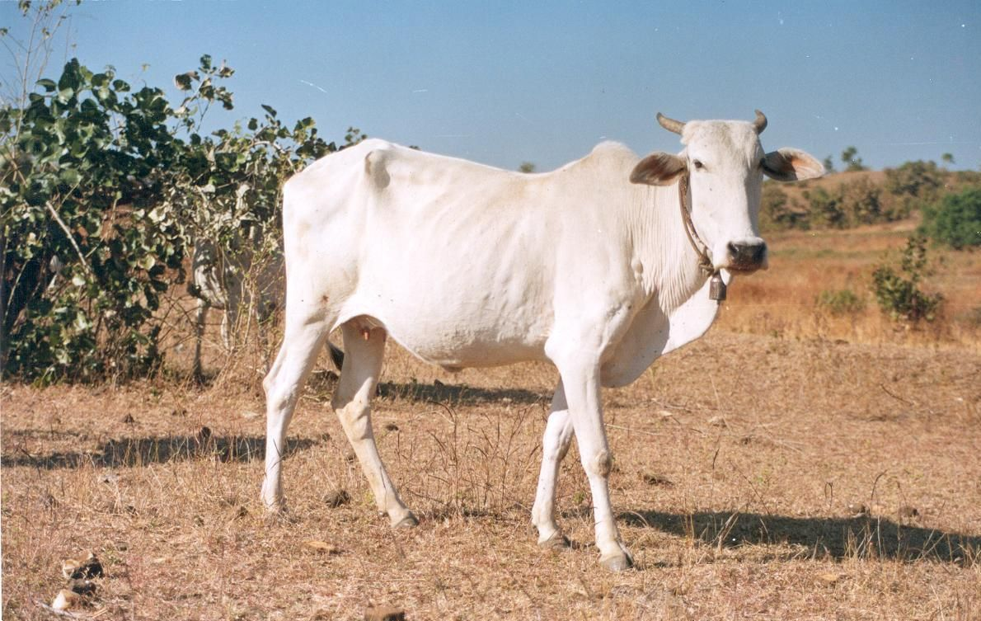
gaolao
Origin:- Wardha district
Physical characters:- 1. Medium size body with long narrow face and flat forehead
2. Eyes are Almond shaped
3. Stumpy and short horn, voluminous dewlap
4. Female are pure white, male grey over head, neck and hump
5. Bullock Wt. 431 kg Cow Wt. 340 kg
Economic characters:- Bullock are good worker; cow are fair milker avg 816 kg in 250 days of lactation.

Slide 18
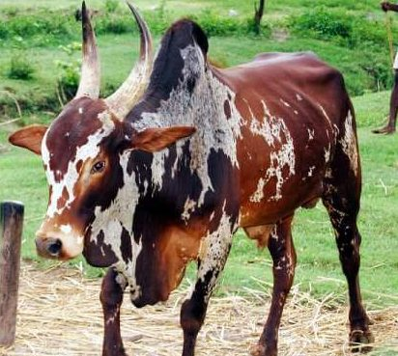
bargur
Origin:- Coimbatore district of TN
Physical characters:- 1. Compact body, forehead no so prominent
2. Horns grow backward and upwards
3. Dewlap well mashed, tail rather short
4. Red and white. Sometime light grey
5. Bullock Wt. 340 kg Cow Wt. 295 kg
Economic characters:- Bullock unsurpassable in hardiness, spiral and speed. Cow are poor milkers

Slide 19
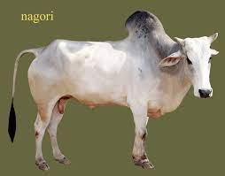
nagori
Origin:- Jodhpur and Nagore district of Rajasthan
Physical characters:- 1. Body long, deep with straight back and well developed flat forehead
2. Face narrow rather long
3. Horns grow outer angle of poll
4. Body colour white or grey
5. Bullock Wt. 408 kg Cow Wt. 340 kg
Economic characters:- Bullock are draught purpose; cow are fair milker avg 3.65 kg of milk per day.

Slide 20
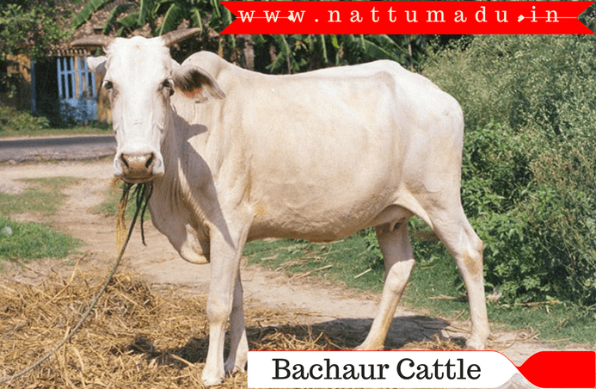
bachaur
Synonyms:- Sitamarhi
Origin:- Sitamarhi district of North Bihar
Physical characters:- 1. Compact body, straight back, well round barrel, flat forehead
2. Compact and firm hump
3. Tail is short
4. Grey in colour
5. Bullock Wt. 385.5 kg Cow Wt. 317.5 kg
Economic characters:- Bullock are draught purpose; cow are poor milker avg 1.35 kg per day.

Slide 21
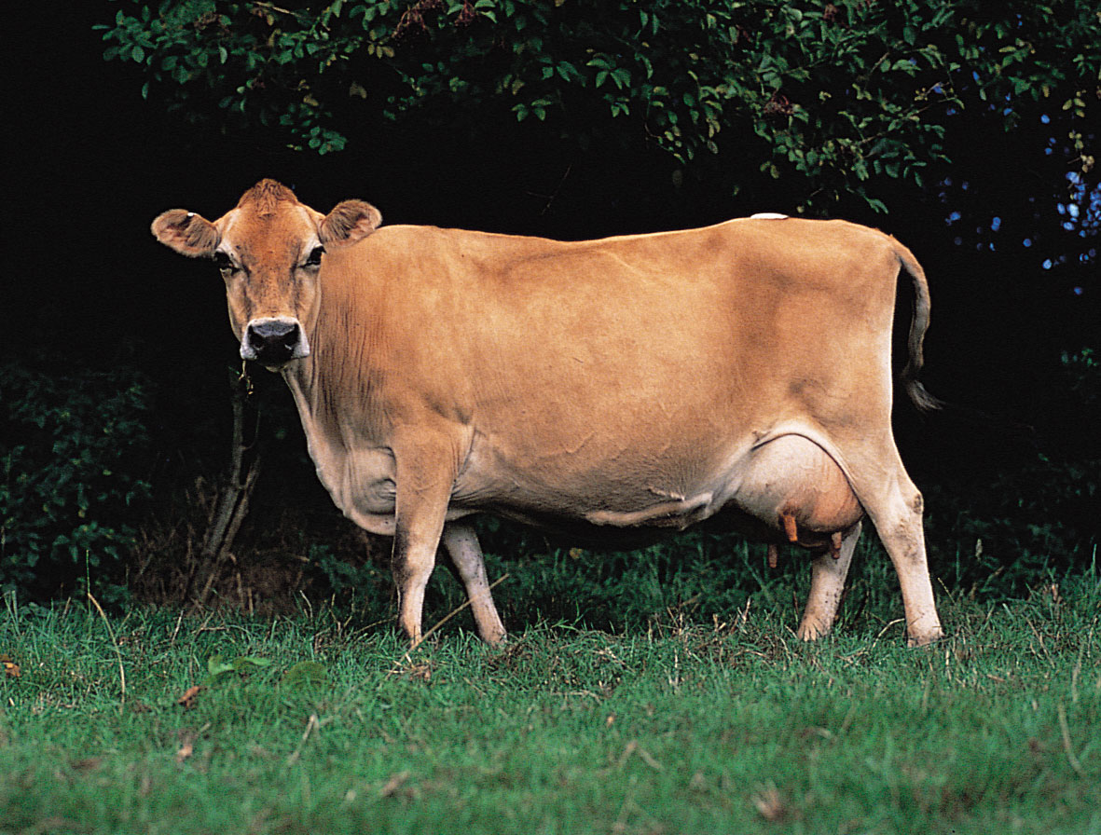
Exotic breed jersey
Origin:- Jersey Island in England
Physical characters:- 1. Compact body, straight top line, sharp wither
2. Head have double dish
3. Horns are small; grow forward and curved inside at the tip
4. Can with stand tropical and humid climate more than the HF
5. Colour brown with or without white marking
6. Bullock Wt. 675 kg Cow Wt. 450 kg
Economic characters:- Age at 1st calving 38 month. Avg milk yield 4000 kg in 305 days of lactation.

Slide 22
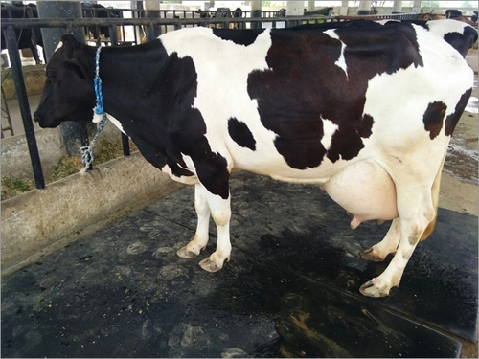
Holstein - friesian
Origin:- Holland
Physical characters:- 1. Animal having large feeding capacity
2. Well developed udder
3. Head is long narrow and straight with rounded wither
4. Black and white colour
5. Bullock Wt. 1000 kg Cow Wt. 675 kg
Economic characters:- Age at 1st calving 36 month. Avg milk yield 6150 kg in 305 days of lactation.

Slide 23
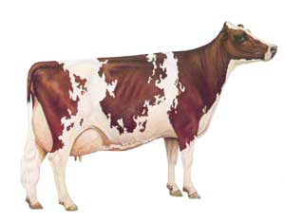
ayrshire
Origin:- Scotland
Physical characters:- 1. Most beautiful breed have straight top line
2. Well developed udder, long horn which are turn upward
3. Shorter thicker neck
4. Red, mahogany, brown combination with white colour
5. Bullock Wt. 850 kg Cow Wt. 550 kg
Economic characters:- Age at 1st calving 40 month. Avg milk yield 4840 kg in 305 days of lactation.

Slide 24
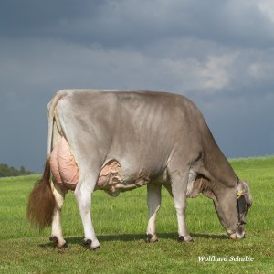
Brown swiss
Origin:- Switzerland
Physical characters:- 1. Use for milk as well as draught purpose
2. Large head with dished and thick loose skin
3. Breed is quite, docile, more heat tolerant than jersey
4. Distinctly colour
5. Bullock Wt. 900 kg Cow Wt. 625 kg
Economic characters:- Age at 1st calving 38 month. Avg milk yield 5250 kg in 305 days of lactation.

Slide 25
Other cross breed animal
1. KARAN SWISS :- Developed by NDRI Karnal Haryana
Sahiwal * Brown swiss
2. KARAN FRIES :- Developed by NDRI Karnal Haryana
Tharparkar * Holstein Friesian
3. PHULE TRIVENI:- Developed by MPKV, Rahuri
HF(50%) * Jersey(25%) * Gir(25%)
4. SUNANDINI:- Originated in kerala
cross of non-descript

Slide 26
Thank you by
NILESH SHELKE

