Slide 1
IMPORTANT BUFFALO BREEDS AND THEIR CHARACTERISTICS
Bubalus bubalis
Water buffalo
Asian Animal
Milk machine
Domestication of buffalo from 2500 to 2100 BC
Domesticated buffalo may be classified in to two categories
1. Swamp buffalo 2N = 48
2. River buffalo 2N = 50
Wallowing :- Rolling in mud or water

Slide 2
Classification of BUFFALO breed
Murrah group | Gujarat group | UP group | Central indian group | South indian group
Murrah Nili-Ravi Kundi Godavari | Surti Jaffarbadi Mehsana | Bhadawari Tarai | Nagpuri Pandharpuri Manda sambalpur | Toda south kanara

Slide 3
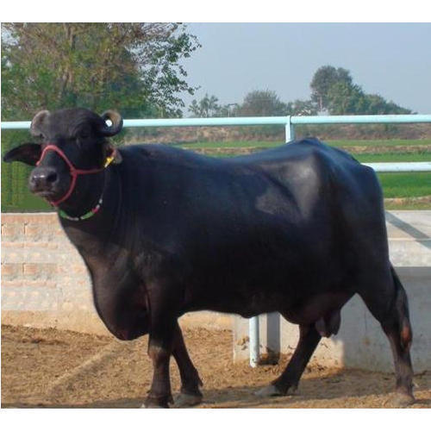
MURRAH
Synonyms:- Delhi buffalo
Origin:- Panjab, Delhi, UP, Rajasthan
Physical characters:- 1. Deep massive frame, broad back, light neck and head
2. Curled horns, well developed udder,
3. White marking on tail with white switch
4. Broad hoofs, jet black colour
5. Buffalo male wt 567 kg & female wt 450 kg
Economic characters:- Age at 1 st calving 42 month & inter calving period is 450 days. yield is 1744 kg milk with 7% fat in 299 days of lactation.

Slide 4
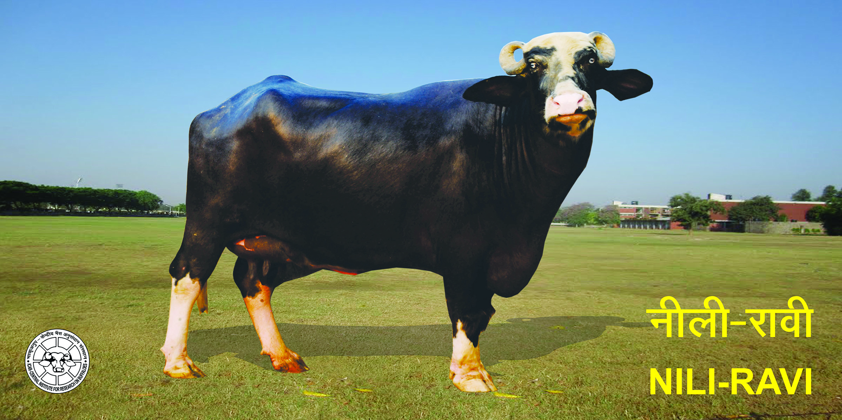
Nili-Ravi
Origin:- Montgomery and Ferozepur district
Physical characters:- 1. Medium size deep frame,
2. Coarse and heavy head, bulging at the top, depressed between the eyes
3. Horns are small with high coil, neck is long
4. Face and forehead that distinguish this breed from murrah
5. Well developed udder , tail touching to the ground
6. Black colour, pink marking on udder and brisket
Economic characters:- Age at 1 st calving 40-45 month & inter calving period is 425-525 days. yield is 1600 kg milk with 7% fat in 250 days of lactation.

Slide 5
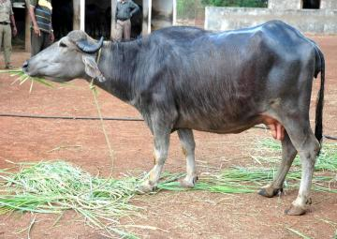
Surti
Origin:- Gujarat
Physical characters:- 1. broad and long head with convex shape in between the horns,
2. Horn are sickle shape, grow downward and backward direction and then upward at tip forming a hook.
3. Long neck, well developed udder
4. Got a unique straight back
5. Black colour with silvery grey hair
6. Long tail with white switch
Economic characters:- Age at 1 st calving 45 month & inter calving period is 460 days. yield is 1600 kg milk with 7.5% fat in 300 days of lactation.

Slide 6
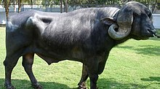
jaffarabadi
Origin:- Gir forest of kathiawar gujarat
Physical characters:- 1. very prominent forehead and heavy horn, inclined to droop on each side of the neck, and turn up at the point
2. Body longer but not so compact
3. Dewlap and udder are well developed
4. Black in colour
5. Male wt 600 kg and female wt 460 kg
Economic characters:- Age at 1 st calving 51-53 month & inter calving period is 450 days. yield is 2100-2200 kg milk with 9% fat in 300 days of lactation.

Slide 7
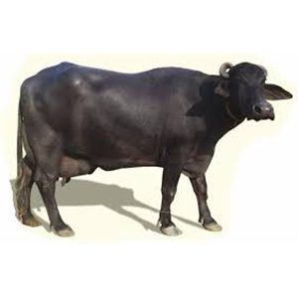
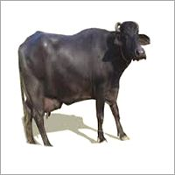
mehsana
Origin:- Gujarat
Physical characters:- 1. Mehsana = Murrah * Surti
2. Medium sized with low-set deep body
3. Jet black colour, sometime grey or white marking on face, legs, tail
4. Reared under stall feeding or grazing condition
5. Horns are resemble the surti or murrah
6. Long neck and body is longer and tighter
Economic characters:- Age at 1 st calving 42-43 month & inter calving period is 480 days. yield is 1800 kg milk with 7.5% fat in 350-365 days of lactation.

Slide 8
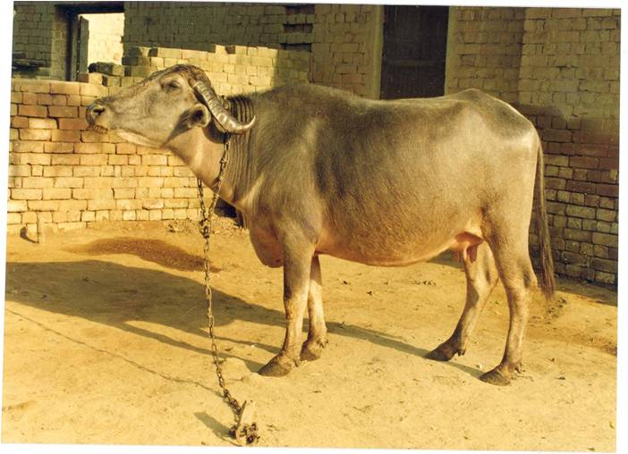
bhadawari
Origin:- Gwalior, Etawah, Agra district of up
Physical characters:- 1. medium sized, wedge shaped body
2. Head bulging towards horns
3. Legs are short but stout
4. Copper colour body with scanty hair
5. Narrow face with slightly marked nose
6. Udder is not so well developed but milk vain are prominent
7. Highest fat % up to 13% fat in milk
Economic characters:- Age at 1 st calving 48-50 month & inter calving period is 453 days. yield is 1111-1252 kg milk with 13% fat in 276 days of lactation.

Slide 9
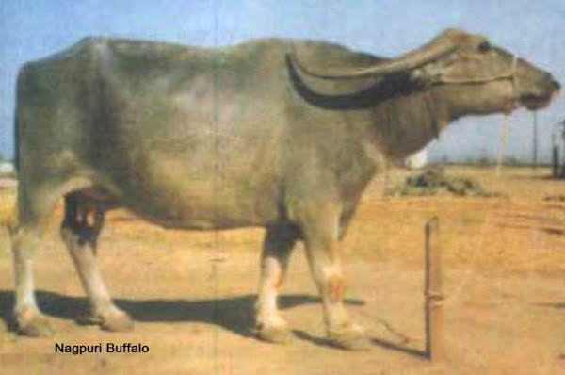
nagpuri
Synonyms:- Marathwada, Berari, Ellichpuri, Gaulani, Varad, Gauli
Origin:- Nagpur region
Physical characters:- 1. Black colour with marking on face, legs and switch
2. Face is long and thin with a straight profile
3. Long neck with heavy brisket
4. Long horns flat curved reaches towards back
5. Breed is lighter type than those of north
6. Male body wt 525 kg and female 425 kg
Economic characters:- Age at 1 st calving 45-50 month & inter calving period is 480 days. yield is 1000 kg milk with 7-8.5% fat in 300 days of lactation.

Slide 10
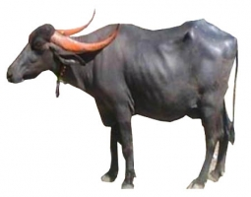
pandharpuri
Synonyms:- Pandharpur, Dharwari
Origin:- South maharastra parts of AP and KN
Physical characters:- 1. Medium size with long compact body with narrow face
2. Short tail, reaching below hock, with white switch
3. Docile in temperament
4. Flat and twisted thin horns
5. Male use for drought purpose
6. Male body wt 450-470 kg and female 400-440 kg
Economic characters:- Age at 1 st calving 45-56 month & inter calving period is 465 days. yield is 1400 kg milk with 7-8.5% fat in 305 days of lactation.

Slide 11
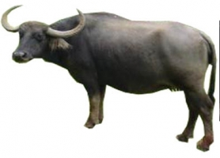
toda
Origin:- Nilgiri hills of TN state
Physical characters:- 1. large size animal having long barrel and strong build
2. Horns are outward, upward and the inward at the top
3. Face short and wide, hump and Dewlap absent, chest is broad
4. Legs are short and sturdy
Economic characters:- Age at 1 st calving 45-50 month & inter calving period is 480 days. yield is 1700-1800 kg milk with 7% fat in 300 days of lactation.

Slide 12
Thank you
By
SHELKE N. R.

